Slide 1
Sustainable Development as Fundamental Pillar of Economic Governance and Public Affairs
9– 10 November 2023, University of Bologna
Mandatory due diligence laws and corporate climate responsibility in international investment law
Monika Feigerlová, Ph.D., LL.M.
Monika.Feigerlova@ilaw.cas.cz
Institute of State and Law
Czech Academy of Sciences
Centre for Climate Law and Sustainability Studies

Slide 2
Climate obligations of companies
SDG 13
Climate Action
Business & Human Rights
International Investment law
Investor’s rights
UN Guiding Principle on Business and Human Rights (GP 8)
Ensuring Policy Coherence
States should ensure that governmental departments, agencies and other State-based institutions that shape business practices are aware of and observe the State’s human rights obligations when fulfilling their respective mandates, including by providing them with relevant information, training and support.
Corporate responsibility to respect HRs

Slide 3
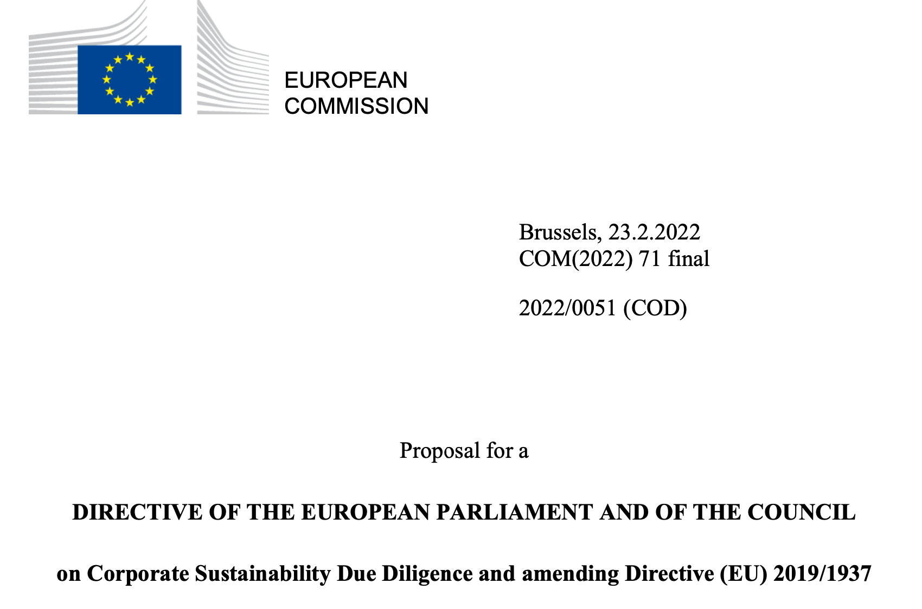
Human rights obligations of businesses
Soft law (international non-binding standards such as UN Guiding Principles on Business and Human Rights, OECD Guidelines for Multinational Enterprises)
Hard law (national legislation on mandatory human rights and environmental due diligence)
  France, Germany, Norway, Netherlands
EU Proposal for Corporate Sustainability Due Diligence Directive

Slide 4
mHRDD laws
legally binding obligations for certain companies to carry out risk-based due diligence aimed at identifying, preventing, and mitigating the human right/ environment /climate - related impacts of their operations
civil liability
administrative liaibility
no direct obligations for business entities under international law

Slide 5
EU Commission’s Proposal CSDD Directive
obligations for companies to conduct human rights and environmental due diligence
  integrating due diligence into their policies
  identifying actual or potential adverse impacts on human rights and environment
  preventing and mitigating potential adverse impacts, and bringing actual adverse impacts to an end and minimising their extent
  monitoring the effectiveness of their due diligence policy and measures
  publicly communicating on due diligence
  establishing and maintaining a complaints procedure
    their own operations, the operations of their subsidiaries, and the value chain operations carried out by entities with whom the company has an established business relationship and
  obligation to adopt a climate transition plan
liability for violations of the obligations
  liability for damage if a company fails to comply with the due diligence obligations and as a result of this failure an adverse impact that should have been identified, prevented, mitigated, brought to an end or its extent minimised occurred and led to damage

Slide 6


Investor’s obligations and responsibility in IIL
Direct legal obligations
Legality clauses (obligation to comply with HS laws)
  sanctions for non-compliance
    denying treaty protections to investments
    considering investor conduct when interpreting IIA protection standards
    providing for State’s right to bring counterclaims in ISDS from investor’s violations of HS law
Incorporating soft law approaches on investor’s responsibilities
  encouraging investors to comply with UNGPs, OECD / to carry out corporate climate due diligence
Agreement between State Parties on strengthening HS laws, including mHRDD
Home State’s measures
  promote investor’s compliance with CSR standards

Slide 7
HRDD clauses in IIAs
SDG 13
Climate Action
Business & Human Rights
International Investment law
Establishing direct legal obligations of HRDD for investors
Obligations of investors to comply with domestic law of the host State (if containing mHRDD)
Provisions on access to remedy in home State
Treaty provisions on impact assessments

Slide 8
Thank you for your attention!
9-10 November 2023
University of Bologna
Questions & Comments
Monika.Feigerlova@ilaw.cas.cz

